Slide 1
BES175: Infrastructure (Transport): DEA definition:
Road
Air
Shipping
Rail
Transport
“Social” Infrastructure
Energy
Communication
Commercial Infra
Survey
Summit
GIFT city
Strategic Oil Reserve
Mega food parks
SEZ, TEE..
Rural Infra <BIPASA>
Urban: Smart City
Water Sanitation: SBM
Notes:
2009
Ministry of Road Transport and Highways
Ministry of Shipping

Slide 2
Before going into Urban and Rural Development
Class I: 100,000 and above; (MAX CITIES HERE)
Class II: 50,000 to 99,999;
Class III: 20,000 to 49,999;
Class IV: 10,000 to 19,999;
Class 5: 5,000 to 9,999
Class 6: <5k rural areas
Rural
NOT Urban
Urban?
Min 75% Male Workers in Non-Agro
Min Pop Density: 400/sqkm
Min 5k Pop
Total ~6 lakh villages
Pak- China occupied not Census’ed

Slide 3
BES175: Infrastructure & Schemes: Rural development
Bijli
Paani [+Sanitation]
Roti & LPG
Makan (IAY, PMAY)
Kapda [Survey to shift smaller towns, Skilling]
Overall
MPLADS, Adarsh Gram, RURBAN etc.
Sadak: PMGSY

Slide 4
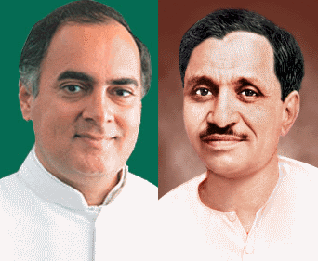
RURAL DEV#1: BIJLI (Electricity)
12th FYP
Rajiv Gandhi gramin vidhyutikaran Yojana
2014 Budget
Discomm: public & private get funding
TARGETS
24/7 electricity to All.
DD Gram Jyoti Yojana
Rural electrification corporation (REC) ltd. (NBFC) Under Power Ministry
Via Metered connection. (muft mein nahi !Fiscal Deficit)

Slide 5

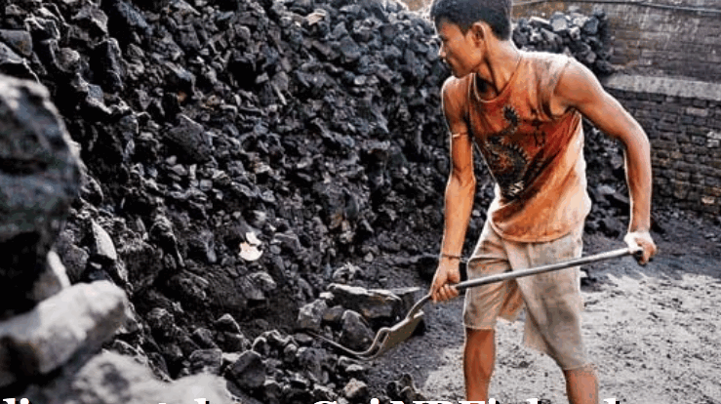
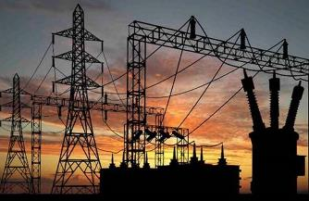



DD Gram Jyoti (not technically correct)
BEFORE
Feeder line
to end user
Power station
Substation
DD GRAM Jyoti: Voltage fluctuations ▼ and Load management ▲
AFTER
Substation
Power station
Agro feeder line
Non agro feeder
New Substation

Slide 6
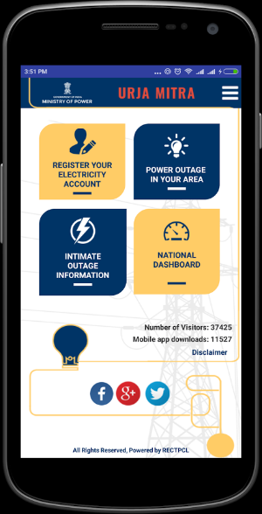
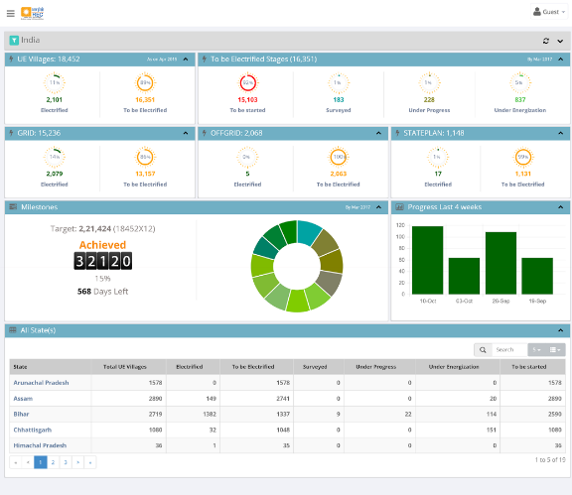

Power Ministry: Rural Electrification Corp (REC-NBFC)
GARV-II: DD Gram Jyoti implementation status
2300 downloads
Power outages
200 downloads

Slide 7
Mock Question for Prelims
Find correct pair
Urja Mitra app: energy saving tips for household.
GARV-II app: implementation status of Gram Jyoti Yojana and UDAY Discomm Assurance Yojana.
Both A and B
Neither A nor B

Slide 8
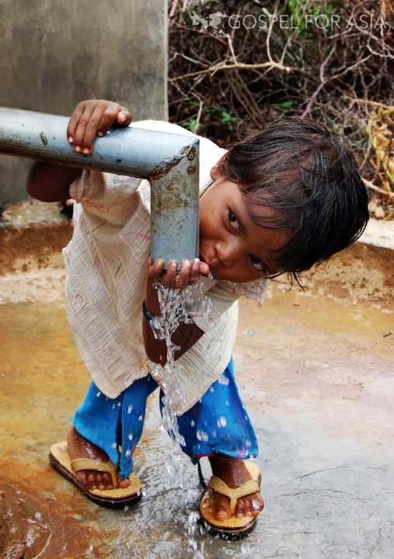
Rural Development #2: PAANI (drinking water = state Subject)
[Earlier in Rural Development ]
2011: Ministry of Drinking water & Sanitation
NRDWP
SMB-G
National Rural Drinking Water Program
Swachh Bharat Mission (GRAMIN)
1992: Rajiv Gandhi…
2002: SWAJLDHARA
2009: NRDWP: 2022 -70 lt water / person / per day. Within household or 50m nearby.
NEXT SLIDE
Budget 2017:
Arsenic and fluoride free habitats

Slide 9
UPSC’s CAPF-2013
Q4. Arsenic present in groundwater can be partially removed
on boiling even if iron is absent in the water
on filtration even if iron is absent in the water. <“pure arsenic insoluble” say some GK Books>
on UV-treatment
along with removal of iron by precipitation/coagulation method if iron is also present in the water
<from advanced chemistry book>
Law of averages = dangerous in this MCQ for Non-B.Sc, IIT

Slide 10
MOCK
Find wrong statement
Rural drinking water is a state subject.
Sanitation is a state subject.
As per 11th Schedule, States must entrust sanitation function to PRI bodies.
None of above
Both usually go together
Absolute are usually wrong
Notes:
Wrong. “state may”. (IYB- Pg732, Laxmi 34.9)

Slide 11
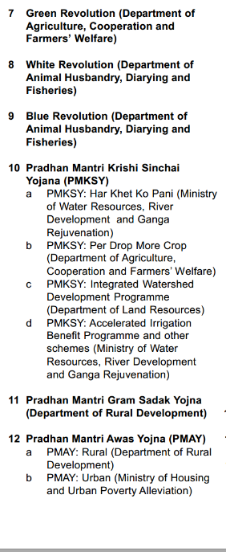
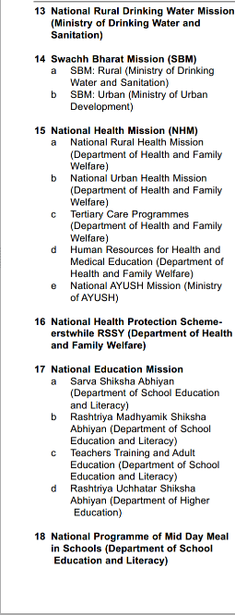
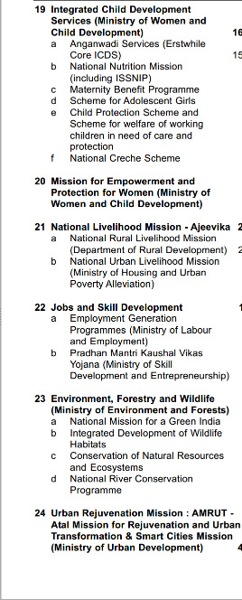
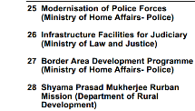
CSS: 28 schemes-6 core of the core= 22 “CORE” Schemes
6k crore +
16k crore+
Type
Core of the core
Core
Schemes
06
Special
22
General
Existing
Existing
90-10
60-40

Slide 12
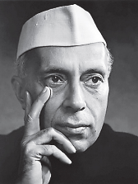
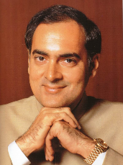
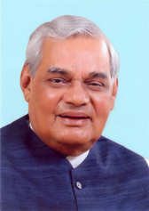
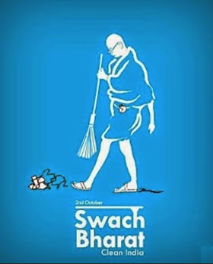
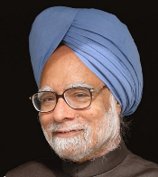
Towards Swachh Bharat
1st FYP
1986
Nirmal Bharat Abhiyan
2014, 2nd Oct
Rural sanitation
Central Rural Sanitation Scheme
1999
Total Sanitation Campaign
2012
SBM
2019: 150th Birth Anniversary’ of Gandhi
100% ODF free, Manual Scavenging free India

Slide 13
Swatch Bharat: administrative structure
National
District collector
State level: Chief Secretary
ULB/PRI Swatchchta Doot (IEC)
Urban areas
Min. Urban development
Rural areas
Min. Drinking water and sanitation

Slide 14
Swatch Bharat: Finance: “CORE Scheme”(60:40| 90:10)
3% national
12% plays, workshop
Services: 0.5% SB Cess.
Rs. 150/- to Swachchta “DOOT” to discourage 1 family
Private Funding
CSR: 2% profit -Companies Act
Budget 2017: Total 16k+
Notes:
Capex: capital expenditure
Opex: operation and maintenance

Slide 15
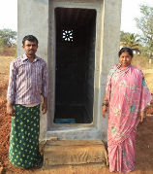
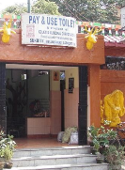
SBM: Toilet Types
Rural
Community (2L) incl. 14th FC grant for PRI
Urban
Individual (12k)
Individual (4k)
Community toilets @slums
Temporary @ construction sites
Public Toilets @bus station, offices etc. (5y maintenance )
@School
+ funding for solid waste management projects

Slide 16
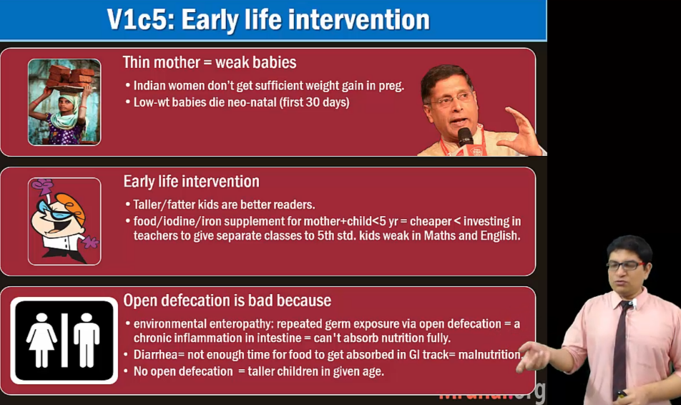
BES166: HDI-> sanitation

Slide 17
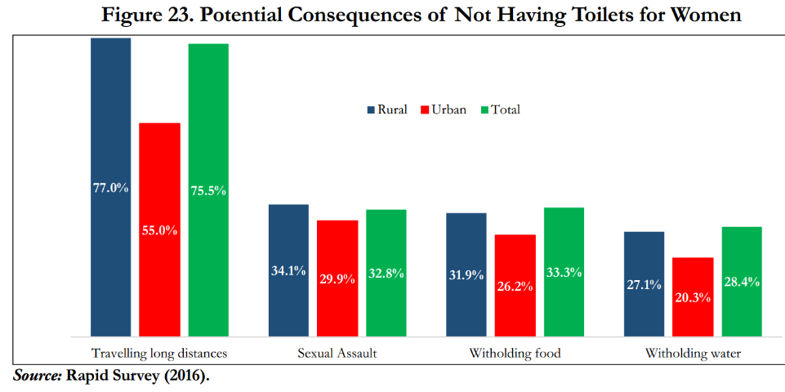
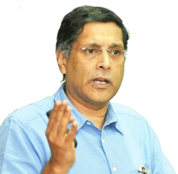
BES17 ”6”: (Ch.1) “Gender Based Sanitation Insecurity”
Fundamental right to “privacy”=> SBM
+ infections in preg. Women=
MMR is high
Malnutrition
-> thinner babies->
poor learning outcomes (ASER)

Slide 18
Mock Question for Prelims
According to economic survey 2016-17, the lack of access to toilet facility leads to which of the following consequences for rural women?
High level of Maternal mortality ratio (MMR)
Malnutrition
Sexual assault
Low weight of babies during child birth
Answer choices
(a) 3 only
(b) 2 and 3 only
(c) 1 and 3 only
(d) 1, 2, 3 and 4

Slide 19

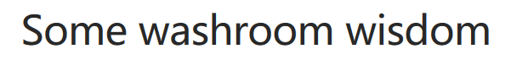
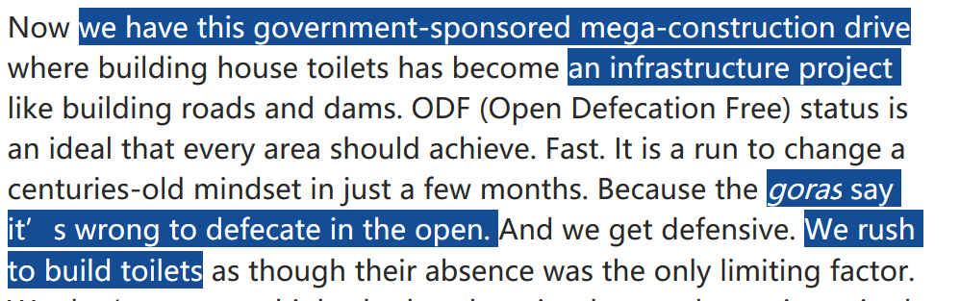
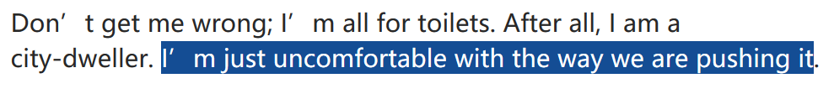
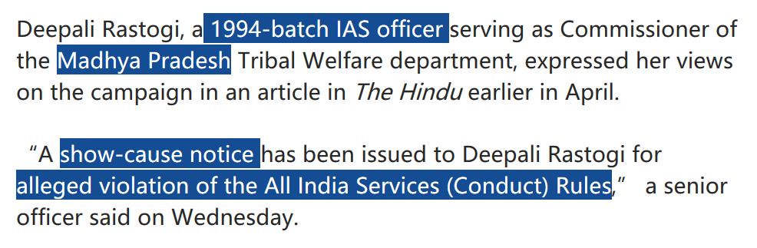
GSM4
Freedom of Speech vs
Service Rules
Notes:
http://www.thehindu.com/opinion/open-page/some-washroom-wisdom/article17759025.ece

Slide 20
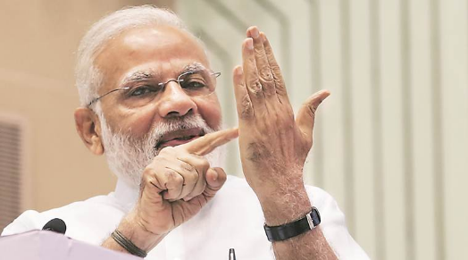
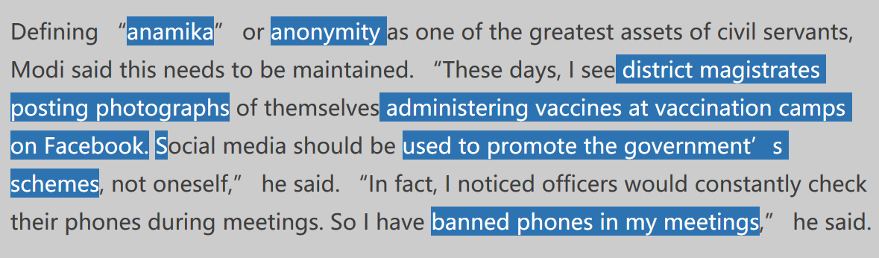
GSM4
Freedom of Speech vs
Service Rules
Civil services
Neutrality
Anonymity

Slide 21
BES175: Infrastructure & Schemes: Rural development
Bijli
Paani [+Sanitation]
Roti & LPG
Makan (IAY, PMAY)
Kapda [Survey to shift smaller towns, Skilling]
Overall
MPLADS, Adarsh Gram, RURBAN etc.
Sadak: PMGSY

Slide 22

By Ministry of Petroleum and Natural Gas
PAHAL (2013, modified 2014)
Give back campaign..X
PM Ujjwala (2016)
Household firewood- pollution, health
2016: LPG connections to BPL [cover 5 cr in next 3 yr].
Rs. 1600 per BPL family [SECC-2011] for initial connection charges.
Make in India: stove, regulator etc.
But refill, stove= EMI.
He has to buy @market prices.
Max. 12 cylinders a year
Rs.10 lakh /> taxable income by husband / wife..X
Pratyaksha Hastantrit Labh Yojana (PAHAL)
LPG cylinder subsidy in bank account.

Slide 23
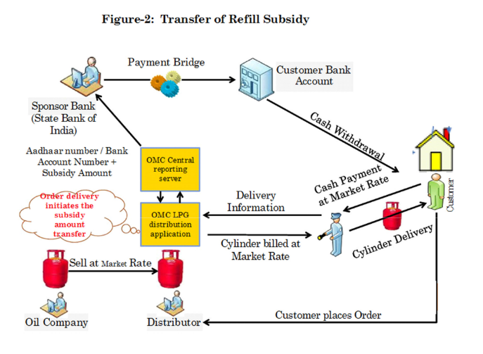
LPG, Kerosense
DBT for Kerosene also.
1/4/2016: Chandigarh became Kerosene free city (since households shifted to LPG)
Similar with Haryana’s 8 districts.
Budget 2017

Slide 24
BES175: Infrastructure & Schemes: Rural development
Bijli
Paani [+Sanitation]
Roti & LPG
Makan (IAY, PMAY)
Kapda [Survey to shift smaller towns, Skilling]
Overall
MPLADS, Adarsh Gram, RURBAN etc.
Sadak: PMGSY

Slide 25

CSS: 28 schemes-6 core of the core= 22 “CORE” Schemes
Type
Core of the core
Core
Schemes
06
Special
22
General
Existing
Existing
90-10
60-40

Slide 26
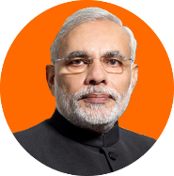
PMAY
WHO
Rural Dev
Gramin: same [23k cr]
When?
1985
FY18
Scheme
IAY
Urban housing [6k cr.]
Beneficiary?
Renamed in 2016, Sept.
Gram Sabha-> BPL
SECC-2011
$$
State officials
Awaassoft-DBT
How much
Less (70-75k)
Plains: Rs. 1.20 lakh
Hills: 1.30 lakh
100% pucca houses by 2022
Convergence with
LPG (Ujjawala)
Electricity (DD Gram Jyoti)
Toilet (SBM_G)…
This is for rural areas.
For urban areas…<NEXT SLIDE>

Slide 27
Min. urban housing and poverty alleviation
Scheme <Rural: IAY-> PMAY_G>
PMAY-Urban (2015-FY22) 100% housing to all
Beneficiary <Rural SECC-2011>
EWS: annual income upto 3 lakh
100% housing to all by FY22? [Rural: 1.2-1.3 lakh DBT]
BEFORE: Rajiv Rinn Detergent Yojana
LIG: 3 to 6 lakhs <states can change>
Private builder: apartments- IF 35% for EWS then subsidy
If person owns land: Rs.1.50 lakh to build / renovate
Credit: Interest subvention <PSL slide…check> 30-60 sqm house
Slum redevelopment
Budget 2017: 6k cr.

Slide 28
Mock Question for Prelims
Find correct statements about PM Awas Yojana-Urban and PM Awas Yojana-Rural:
Both provide interest subvention to the poor families for buying or constructing house.
Both use SECC-2011 data to identify beneficiaries.
Both are 100% centrally sponsored schemes.
Both aim for 100% housing to all, by 150th birth anniversary of Gandhi.
Answer choices:
(a) 1 and 4 only
(b) 2 and 3 only
(c) 1, 3 and 4 only
(d) None of them.

Slide 29
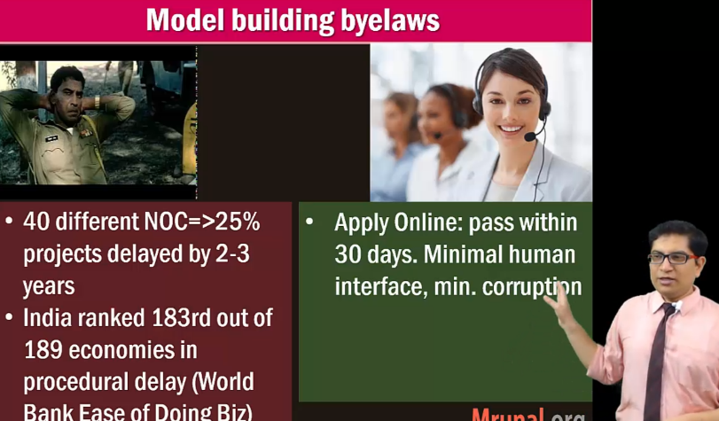
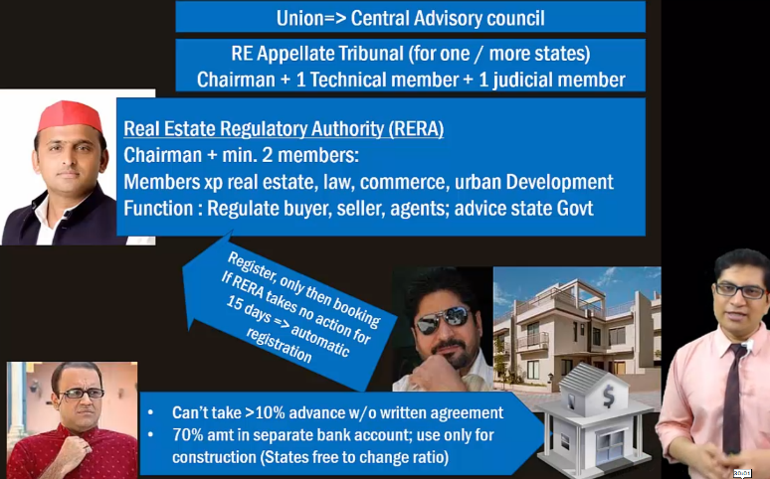
BES165: Rail Budget end portion + prsindia.org

Slide 30
BES175: Infrastructure & Schemes: Rural development
Bijli
Paani [+Sanitation]
Roti & LPG
Makan (IAY, PMAY)
Kapda [Survey to shift smaller towns, Skilling]
Overall
MPLADS, Adarsh Gram, RURBAN etc.
Sadak: PMGSY

Slide 31
Under Panchayati Raj Ministry
1 MP- 1 Idea
MOSPI competition
3 best entries from each LS constituency win price (2012)
2013: RGPSA
Building, renovation, training
2007: BRGF
2015: BOTH STOPPED
14th FC 2 lakh cr. Grant-in-AID for PRI
for school, water, streetlights etc. infra.
Backward Region Grant Fund
Addl. $ to backward areas
Rajiv Gandhi Panchayat Shasaktikaran Abhiyan
1993-MPLADS
M.P. Local Area Dev. Scheme. Rs. 5 cr /Constituency, Non lapse
MOSPI (Rs.3,950 cr)
2014: Shyama P. Rurban Mission
Rs. 1k cr.<in smart city segment of this ppt, we’ll see>
2014: Adarsh Gram
Rs. 0 cr. Under Rur.Dev
Next slide..
Notes:
Some columnist suggesting do it again.

Slide 32
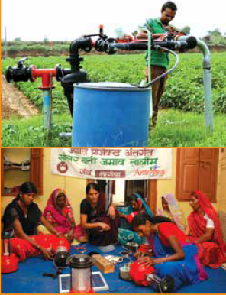
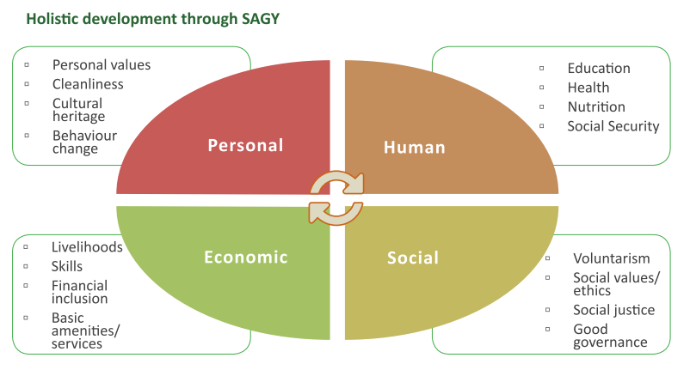
Sansad Adarsh Gram 2014 (Rural Development Ministry)
TARGET
WHERE?
RS: His State (Smriti: Anand dist, Jaitley: Vadodara)
Adopt 1 village by 2016, 2 by 2019; till 2024: 1 each year = total 6433/2.65 l GP
Plains: 3k-5k pop. \ Hill: 1k-3k population
should not be his / spouse' village
Nominated : anywhere (sachin AP)
WHAT to do?
Personal attention to schemes
Library via donation,
Village song, remember martyrs, celebrate girl child birth, plant trees etc.

Slide 33
Mock Question for Mains
Socio-economic transformation of Rural India can’t be achieved without inculcating the sense of pride & volunteerism among its citizens. Discuss the importance of Sansad Adarsh Gram Yojana in this regard.
Celebrate girl child =women discrimination..X
Martyrs, Village song =caste barrier
Library through donation= caste barrier
Tree planting, cleanliness drive

Slide 34
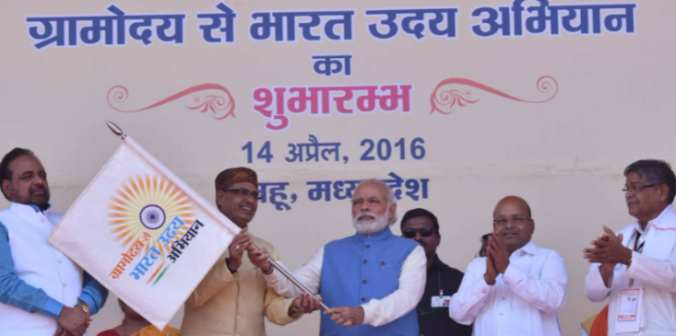
GRAM uday to Bharat udhay 2016
When?
14 April: Dr.Ambedkar 125th Anniversary TO
24th April: Panchayati Raj Day
What?
Social harmony program
Panchayat Min + Soc.Justice
Gramoday sankalp quarterly magazine and its app.
2014: Unnat Bharat Abhiyan, HRD Min
IIT, NIT etc. make technologies for local / rural India.

Slide 35
Overall: BHARAT NIRMAN vs AMRUT MAHOTSAV
Bharat Nirman 2005
Phase-I: 2005-09
Phase-II: 2009-12
Amrut Mahotsav 2022
Rural Infra: irrigation, housing, water supply, electrification and telecommunication
75th year of Independence
Similar e.g. 2x farmer income, housing to all, 70 lt. waters to all.
+2019: ODF free India, 50k GP poverty free.

Slide 36
BES175: Infrastructure (Transport): DEA definition:
Road
Air
Shipping
Rail
Transport
“Social” Infrastructure
Energy
Communication
Commercial Infra
Survey
Summit
GIFT city
Strategic Oil Reserve
Mega food parks
SEZ, TEE..
Rural Infra <BIPASA>
Urban: Smart City
Water Sanitation: SBM
Notes:
2009
Ministry of Road Transport and Highways
Ministry of Shipping

Slide 37
Urban Development
Class I: 100,000 and above; (MAX CITIES HERE)
Class II: 50,000 to 99,999;
Class III: 20,000 to 49,999;
Class IV: 10,000 to 19,999;
Class 5: 5,000 to 9,999
Class 6: <5k rural areas
Urban
Rural
NOT Urban
Urban?
Min 75% Male Workers in Non-Agro
Min Pop Density: 400/sqkm
Min 5k Pop
Semi-urban
rural

Slide 38
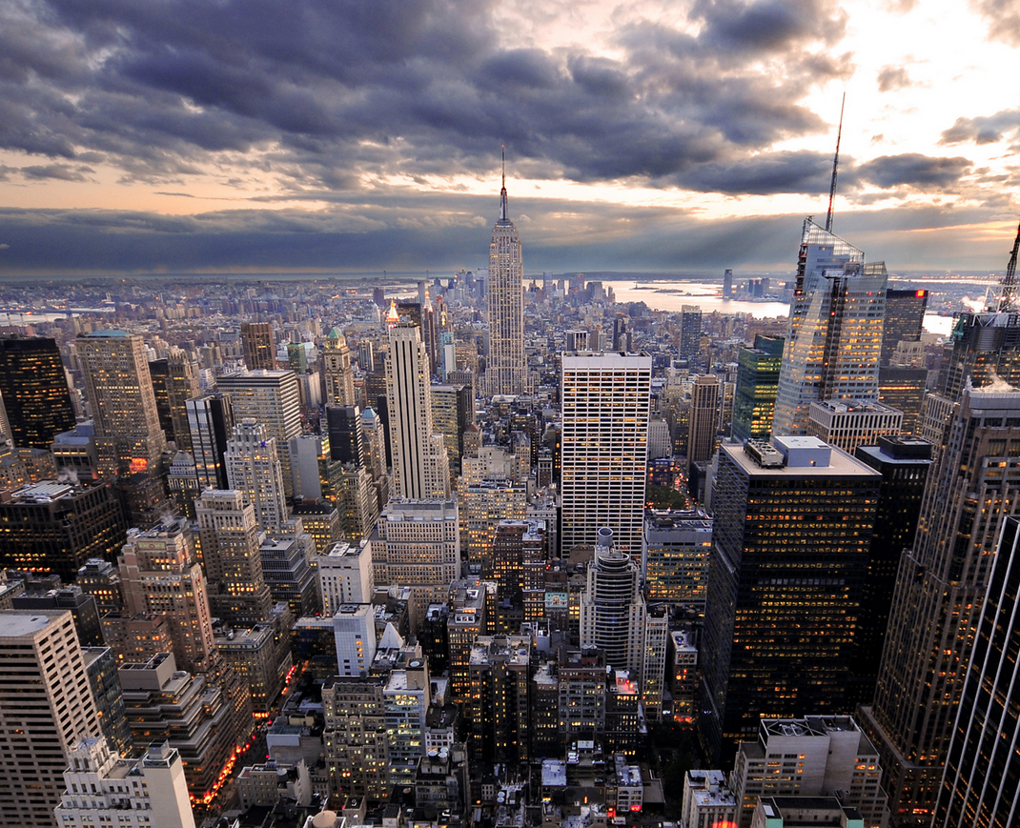
Class-1 cities classification
Megacity 1 cr/>
Million+ city
Town = Class-1 = 1l / >
Mumbai, Delhi, Kolkata
Metro city
Metropolitan Area 10l / >
If spread in 2 / more municipalities
40l / >
10l />

Slide 39
Urban area
Statutory towns
Census towns
Outgrowths
municipality, corporation, cantonment board or notified town area committee, etc. (4041+)
Min 5k people; min.75% engaged in non-agro; Min. density: 400/sqkm (3892+ census towns)
Railway colony, uni.campus etc. wherein Electricity, post-office, bank etc. available

Slide 40
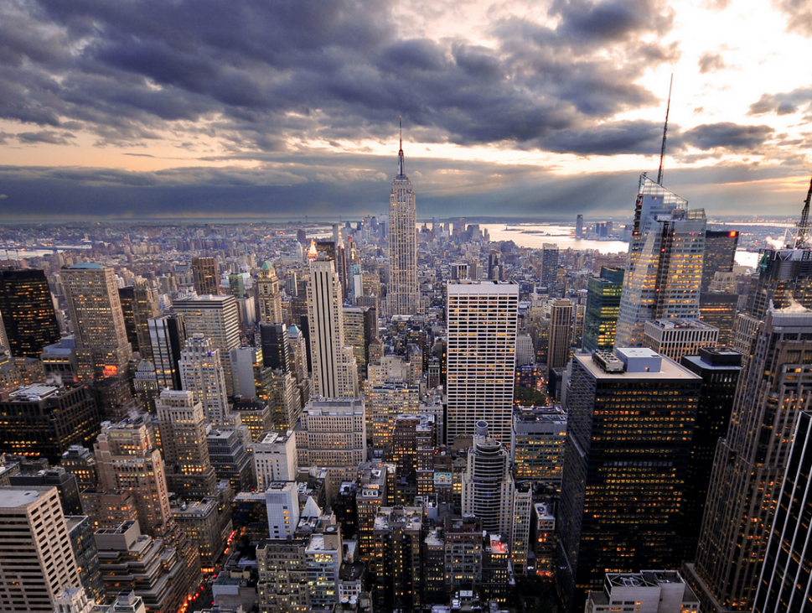
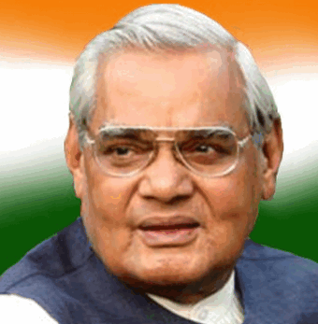
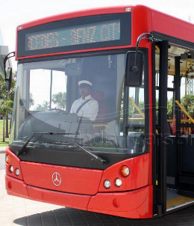
Urban Development Ministry
JNNURM-05
Jawaharlal Nehru National Urban Renewal Mission (JNNURM)
Sub missions: water supply, sanitation, transport - BRTS, waste Management
AMRUT-2015
Atal Mission for Rejuvenation and Urban Transformation (AMRUT)
500 cities w/ 1 lakh+population
10 years plan x Rs.2 lakh crores
Every house with tap, sewage-> organic farming
Parks, wifi zones, mass transport, walking-cycling paths
Union will not appraise each project. It’s left States=> Cooperative Federalism

Slide 41
CSS: 28 schemes-6 core of the core= 22 “CORE” Schemes
Type
Core of the core
Core
Schemes
06
Special
22
General
Existing
Existing
90-10
60-40
9k crore allotted

Slide 42

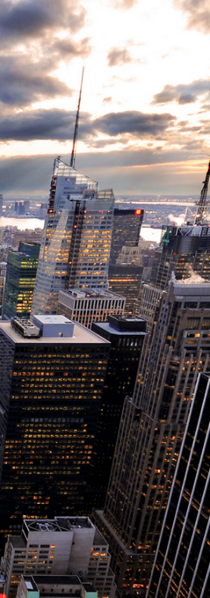
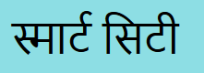
हुशियार शहर
2015, MoUD

Slide 43
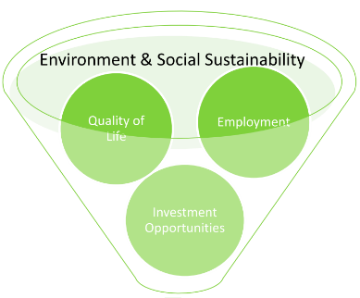
Smart City: Definition
Smart infra
Physical
Smart “-y”
Utility
VIA some %
Social / civic
Economic
100% ICT but not “end”
0% Bureaucratic hassles
Technology
Mobility

Slide 44
Smart City: benchmarks and Features
Multimodal: road (BRTS), waterway, rail: (Metro, Mono, TRAM)
Bypass, underpass, overbrides
Walking lanes, Public cycle sharing.
10-15m public transport. Connected to RURBAN clusters
Swachh Bharat_U
Heavy penalties for littering, misuse of water
ICT: Rain water harvesting, storm water drainage
Automated streetlights
Self healing smart grids
10% RE rooftop solar
(Bi)Electricity
(Pa) Water
(Sa) Transport

Slide 45
Smart City: benchmarks and Features
Rajiv Rinn Yojana: PMAY (U)
SARDAR Housing Mission: by 2022 all (now, PMAY-U?)
20% houses for LIG/EWS
Within 400m school, mall, parks
Nursery to College
1 college x 1.25 lakh population
1 PH inst x 45k pop
[1 medical, 1 paramedi] x 10 lakh
1 engineering x 10 people
…..
Housing
Education

Slide 46
Smart City: benchmarks and Features
Telemedicine, 108
30 minutes response time
1 dispensary x 15k
Multispecialty hospital: 200 beds per 1 lakh pop
Even veterinary hosp per 5 lakh
Wifi @all houses @100mbps
24 x 7 water, electricity, emergency, medical service, fire service
telephone services
Banking kiosk, digital payments @metro etc.
Skill dev, startup incubation
Financial centres like GIFT city
Warehousing, freight terminals, export parks.
Communication
Economic
Healthcare

Slide 47
Cities nomination->States->MoUD-> Smart city plan (SCP)
Pan City: ICT solutions | Finance model
Surrounding area
Greenfield City Extension- 250ac, land pooling
Existing city (brownfield)
retrofit (=upgrade, 500acr)
Redevelop (=replace, 50acr)
Notes:
For North Eastern and Himalayan States, the area proposed to be developed will be one-half of
what is prescribed for any of the alternative models - retrofitting, redevelopment or greenfield
development.

Slide 48
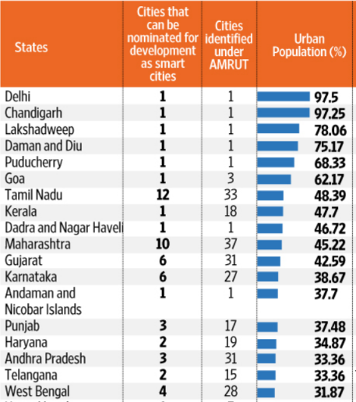
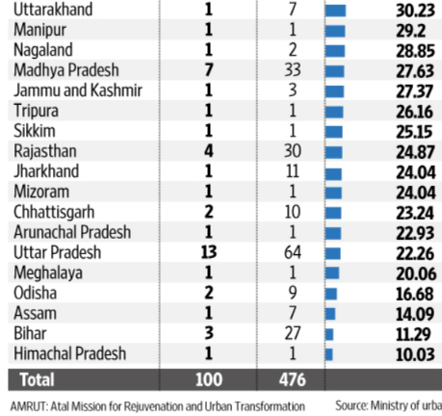
SCP to MoUD-> How many “vacancies”?
Total 100 smart cities and 500 AMRUT cities
Quota for individual states?
50% wt to urban population
50% wt to no. of statutory towns
--- UP>TN>Maharashtra

Slide 49

100 Toppers for Smart city->SPV formation
Uttar Pradesh | 13 | Moradabad, Aligarh, Saharanpur, Bareilly, Jhansi, Kanpur, Allahabad, Lucknow, Varanasi, Ghaziabad, Agra, Rampur
Tamil Nadu | 12 | Tiruchirapalli, Chennai, Tiruppur, Coimbatore, Vellore, Salem, Erode, Thanjavur, Tirunelveli, Dindigul, Madurai, Thoothukudi
Maharashtra | 10 | Navi Mumbai, Nashik, Thane, Greater Mumbai, Amravati, Solapur, Nagpur, Kalyan-Dombivali, Aurangabad, Pune
Madhya Pradesh | 7 | Bhopal, Indore, Jabalpur, Gwalior, Sagar, Satna, Ujjain
Gujarat | 6 | Gandhinagar, Ahmedabad, Surat, Vadodara, Rajkot, Dahod (!?)
Karnataka | 6 | Mangaluru, Belagavi, Shivamogga, Hubballi-Dharwad, Tumakuru, Davanegere
Rajasthan | 4 | Jaipur, Udaipur, Kota, Ajmer
West Bengal | 4 | New Town Kolkata, Bidhannagar, Durgapur, Haldia
Andhra Pradesh | 3 | Vishakhapatnam, Tirupati, Kakinada
Bihar | 3 | Muzaffarpur, Bhagalpur, Biharsharif
Punjab | 3 | Ludhiana, Jalandhar, Amritsar
Chhattisgarh | 2 | Raipur, Bilaspur
Haryana | 2 | Karnal Faridabad
Odisha | 2 | Bhubaneshwar, Raurkela
Telangana | 2 | Greater Hyderabad, Greater Warangal

Slide 50
100 Toppers for Smart city ->SPV formation
Arunachal Pradesh | 1 | Pasighat
Assam | 1 | Guwahati
Chandigarh | 1 | itself
Dadra and Nagar Haveli | 1 | Silvassa
Daman and Diu | 1 | Diu
Delhi | 1 | NDMC
Goa | 1 | Panaji
Himachal Pradesh | 1 | Dharamshala
Jharkhand | 1 | Ranchi
Kerala | 1 | Kochi
Lakshadweep | 1 | Kavarrati
Manipur | 1 | Imphal
Meghalaya | 1 | Shillong
Mizoram | 1 | Aizawl
Nagaland | 1 | Kohima
Puducherry | 1 | Oulgaret
Sikkim | 1 | Namchi
Tripura | 1 | Agartala
Uttarakhand | 1 | Dehradun
A&N | 1 | Port Blair
J&K | 1 | PENDING (send proposal of Jammu and Sri Nagar)
Total | 100

Slide 51

Budget 2015: National Investment and Infrastructure Fund (NIIF)
Government
Rs. 20k cr
Financially viable
Fund of the funds
AIF Cat-II
fund1
Greenfield
fund2
Brownfield
Rs.40k
Crores
Other sources
Rs. 20k cr
fund3
Budget 2017
1k cr allotted
16k cr mobilize by itself (AIIB, BRICS Bank, market borrowing etc.)
Under Indian trust act, Dept of Economic affairs
REITs, INVITs, Wholesale Bank etc covered.
PPP: more under mains
Notes:
Government stakes will not >49%

Slide 52
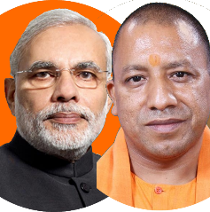
Funding of smart city: 48k cr union + 2k cr. NIIF= 50k cr. <in next five years from 2015>
Union
50k cr
State/UT
50k cr.
Total
1 lakh cr
Divided
100 cities
Per city: 1k cr
In the next five years. (2015)
SPV: Companies Act
State /UT (x%); Min. 100cr
Private co / FI (100-2x)%
ULB (x%); Min.100cr
Collectively majority shareholding
Borrowing, user fees, can collect taxes with approval of ULB, NIIF,
14th FC allocation, other schemes, PPP

Slide 53
Mock Question for Prelims
Find correct statement(s) about AMRUT Mission and Smart City Mission
AMRUT mission has higher total outlay by union Government than Smart city mission.
Both uses same formula for determining total number of beneficiary cities in each state.
Both are core schemes implemented by Urban Development Ministry.
Answer choices:
a) Only 1 and 2 (b) Only 2 and 3
c) Only 1 and 3 (d) all of them

Slide 54
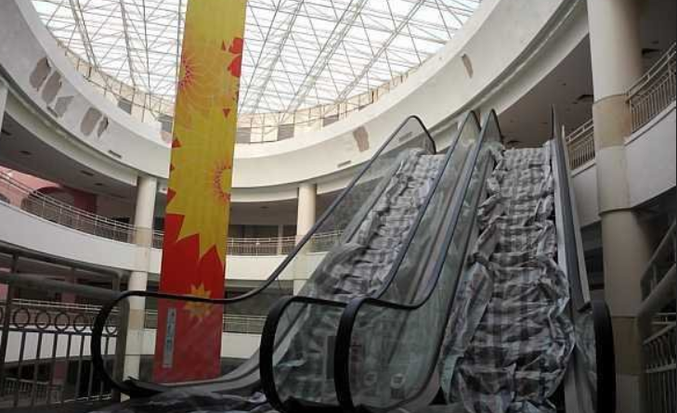
Criticism of Smart Cities
Soul / Sense of place gone
China: Ghost cities
Privacy- Cyber Security
Unique identity will be developed
But they were greenfield, ours is brownfield.
Biased?
Allotment politics
iOT (internet of things): metro hacked to collide with incoming train?
Spam, billboards
Elitists < counter RURBAN >

Slide 55
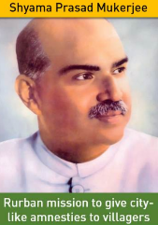
From PURA to RURBAN
2004: PURA
Kalam’s brainchild: PURA (Providing Urban Amenities in Rural Areas)
Failed to takeoff because inter-ministerial coordination …x
2014: SPMRM
Shyama Prasad Mukherji Rurban Mission (SPMRM)
Rural Development ministry
Inspired from Guj

Slide 56
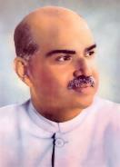
Dr. Shyama Prasad Mukharjee
1901-1953
UK Barrister, Youngest VC of Calcutta Univ.
Active in Asiatic Society
President Hindu Mahasabha
Bharatiya Jansangh founder
Opposed Sarat Suharawady pact (to create “Bengal country)
Free India: Industry minister
Pro-Uniform civil code, Anti-370, No to Delhi pact
Scheme: Rurban mission
PM Nehru vs PM Liaqat Ali Khan 1950
Post-partition Refugee rehab.
Return women, Property, “Ghar wapsi” (forced conversions unrecognized)
Equality citizenship to minorities
Appoint minority commission to implement above things.
Dr.Mukhrjee resigned because 2 past pact fail, Pak won’t enforce this.

Slide 57
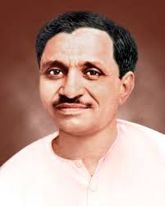
Pt. Deendayal Upadhyaya
1916-1968
Born Mathura dist. UP. (Modi 1 year completion speech)
Bharatiya Jan Sangh (BJS): General Secretary for 15 years
Political philosophy “Integral Humainism” (BJP)
Editor of Panchjanya and Swadesh
Scheme: Gram Jyoti, Antyodaya Yojana

Slide 58
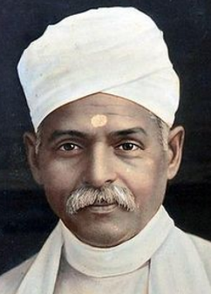
Pt.Madan Mohan Malviya
1861-1946
Lawyer from Allahabad,
Member of provincial & central legislature.
Founder: Banaras Hindu University (BHU), Hindu Mahasabha, “The Leader” newspaper.
Editor of The Hindustan, Indian Union and Abyudaya.
Moderate INC leader, 4x President
Gandhiji gave title “Mahamana”
Popularized slogan “Satyamev Jayate”
Opposed separate electorate for Muslims under Lucknow pact of 1916
Was in 1st RTC 1930
Setup Congress Nationalist Party to oppose communal award
Budget 2014: Teachers training program
Malviya’s Birthday 25th December (same as Vajpayee).
44th Bharat Ratna, 2014. (Vajpayee -45th)

Slide 59
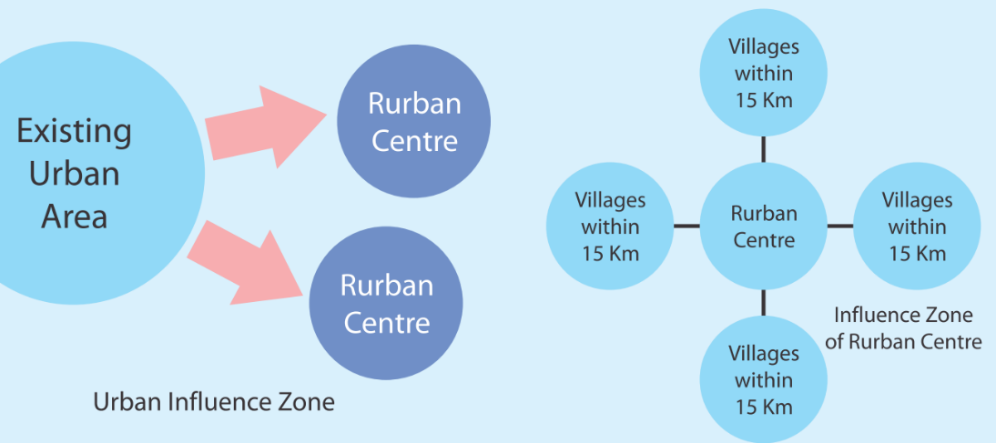
Cluster of “Smart” Gram Panchayats=> State identify=>MoRD approve
Plain & Coastal
25000 to 50000
Desert, hilly,tribal
5000 to 15000
300 clusters
In next 3 years
Bijli (energy)
Paani
Sadak
Street lights
LPG gas connections.
Piped water supply
Sanitation
waste management
Inter-village road
Public transport
Village streets and drains
Bi-Pa-Sa
S-S-C
Total 14 components
Siksha
Upgrading school
Digital Literacy
Skill training
Swasthya
Mobile health unit
Centre
Agro Processing warehouse
E-gram/Citizen Service Centres

Slide 60
CSS: 28 schemes-6 core of the core= 22 “CORE” Schemes
1k crore allotted
Type
Core of the core
Core
Schemes
06
Special
22
General
Existing
Existing
90-10
60-40

Slide 61

Tourism infra: 100% CSS: PRASAD & HRIDAY
Prasad (tourism)
Hriday (MoUD)-2015
Heritage City Development and Augmentation Yojana
Urban Development Min.
Pilgrimage Rejuvenation and Spirituality Augmentation Drive
Tourism Min.
100% CSS
100% CSS
100 cr. In budget 2017
150 cr. In budget 2017
3 years (2015-ending @ March 2017? survey)
Five years (2015-20)

Slide 62
Tourism- 100% CSS: PRASAD & HRIDAY
Prasad (Tourism)
Hriday (MoUD)
Public transport, water and solid waste management, sanitation.
ATM, foreign currency exchange counters
Street furniture, battery-operated vehicles, smart signs- Digital brochure, kiosks
Cultural events, fairs, festivals
Museum and cultural spaces
Wi-Fi, CCTV cameras
Cottage industry, handloom industry: market haats
Training tour operators, guides, local artisans and women entrepreneurs
Rail, road water transport
Green energy streetlights
Water adventure sports
Emergency vehicle breakdown repair and refueling facilities
First-aid centres, Wi-Fi hotspots, Parking facilities
Green landscaping, water fountains, walkways, furniture etc.
Removing encroachments

Slide 63
Tourism- 100% CSS: PRASAD & HRIDAY
Prasad (Tourism) 13 cities as of 2016
Hriday (MoUD) 12 cities as of IYB’17
Ajmer, Amaravati, Amritsar, Badami, Dwarka, Gaya, Kanchipuram, Mathura, Puri, Varanasi, Velankanni and Warangal.
Amritsar, Ajmer, Dwaraka, Mathura, Varanasi, Gaya, Puri, Amaravati, Kanchipuram, Vellankanni, Kedarnath, Kamakhya and Patna.
+ SWADESH Darshan scheme Under Tourism ministry
theme based 13 tourist circuits

Slide 64
BES175: Infrastructure (Transport): DEA definition:
Road
Air
Shipping
Rail
Transport
“Social” Infrastructure
Energy
Communication
Commercial Infra
Survey
Summit
GIFT city
Strategic Oil Reserve
Mega food parks
SEZ, TEE..
Rural Infra <BIPASA>
Urban: Smart City
Water Sanitation: SBM
Notes:
2009
Ministry of Road Transport and Highways
Ministry of Shipping

Slide 65
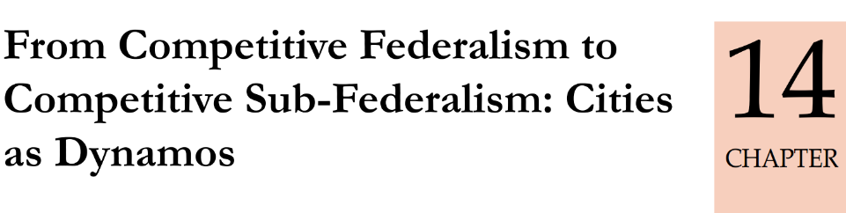

Parameter
Urban
Pop
1/3rd
GDP
3/5th

Slide 66

Zipf’s law:
Largest city
3x than 3rd largest..
2x size than 2nd largest
n^{th} city should be 1/n’th size of largest city
Indian cities are unusually small.
“Space scarcity” -> high rents ▲-> Labour mobility ▼
Notes:
linguist George Kingsley originally for words?

Slide 67
ULB challenges:
#1: Governance challenge
#2: Infrastructure Deficit
Fragmentation of responsibilities between
State vs Muni cadre
Water, power, road, health..
next 20 years ~60 lakhs cr. req. for infra+ their O&M.
But 14th FC, smart city ☹

Slide 68
14th FC: Grant in Aid for Local Bodies (2015-20)
Union
State
Rural
Urban
State
90% basic
10% Performance
80% basic
20% Performance
2.87 Lakh cr.
Horizontal: 90% Population (2011) + 10% Area
87,000 cr
Barely 500 per person per year☹
2 lakh Cr.

Slide 69
14th FC: ▲ devolution & Revenue re$ource$ for ULB
Mining royalty
Property tax
New Entertainment tax
▲ Professional tax ceiling
Advertisement tax
Cable, Café
Boat ride
Amend Art. 276
Assess every 4-5 yr
Devolve: ▲Rate on Inflation, Development
Union Property
Art.285(1) can’t be taxed by state/Local
At least Compensate
Corporation can, but some states’ municipalities can’t. so fix it
States should share
2500=> 12k
difficult to issue Muni. Bonds because governance poor, tax base is narrow

Slide 70

Jaipur and Bangalore
GIS mapping using NASA’s LANDSAT: how much property development?
But their ULB hardly getting 5-20% of real potential!
Many exemptions, low rates, populism: illegal buildings, later regularized during election seasons
Undervaluation: Poor enforcement, lack of staff
If even 80% compliance= 22k cr (said 14th FC)

Slide 71

Bolbachchan
Pune, Mumbai less number of taxes yet make more than Kanpur and Dehradun Because TAX BASE is bigger

Slide 72
Lessons from Jamshedpur vs Gurgaon
Jamshedpur, Jharkhand
Tata Steel’s private township in Jharkhand
Gurugram, Haryana
Provides basic amnesties to citizens: water, sewage etc.
Till 2001: agri wasteland, 2008: Haryana Urban Dev Authority (HUDA) + Muni. Corp of MCG (2008)
Private sector: road, sewage, water..
Negative externalities: diesel fumes, dumping etc.
Lack of civil society
Higher transaction cost for private operators because multiple bodies.
Survey suggestion:
Promote proprietary competitive cities: build, compete, innovate, experiment. Etc.

Slide 73


Janaagraha: Annual Survey of India's City System 2015 (ASICS-2015)
Direct correlation of
Service delivery with
Staffing
Expenditure

Slide 74

Janaagraha: Annual Survey of India's City System 2015 (ASICS-2015)
Survey:
MoUD release transparency data
NITI should release performance index.
Longer Mayor tenure = better outcomes (not much)
Directly elected mayor : service availability low (INVERSE)
->If Directly elected mayor doesn’t have elected council’s support then difficult to work
Hence Rajasthan & Tamilnadu shifting to Indirectly elected Mayor

Slide 75


Self study for Prelims: direct vs Indirect Mayor Lecture
Self study for Mains: GSM1: urbanization-problem, remedies Lecture

Slide 76


demonetized
NOT demonetized, It’s carry forward

Slide 77


Economy: 6 pillars + theory + current + BES17 (pre cum Mains)
1.Banking, Fin, Insur.
6.HRD
2.Budget
3.BoP
4.Sectors
5.Infra
V1:c3,4
V1:c2,3, 6,9,11(GST),13
V1c:5
V1c:7(Textile),11(trade)
V1c:10
v1c:12, 14; Budget^Rail

